Slide 1
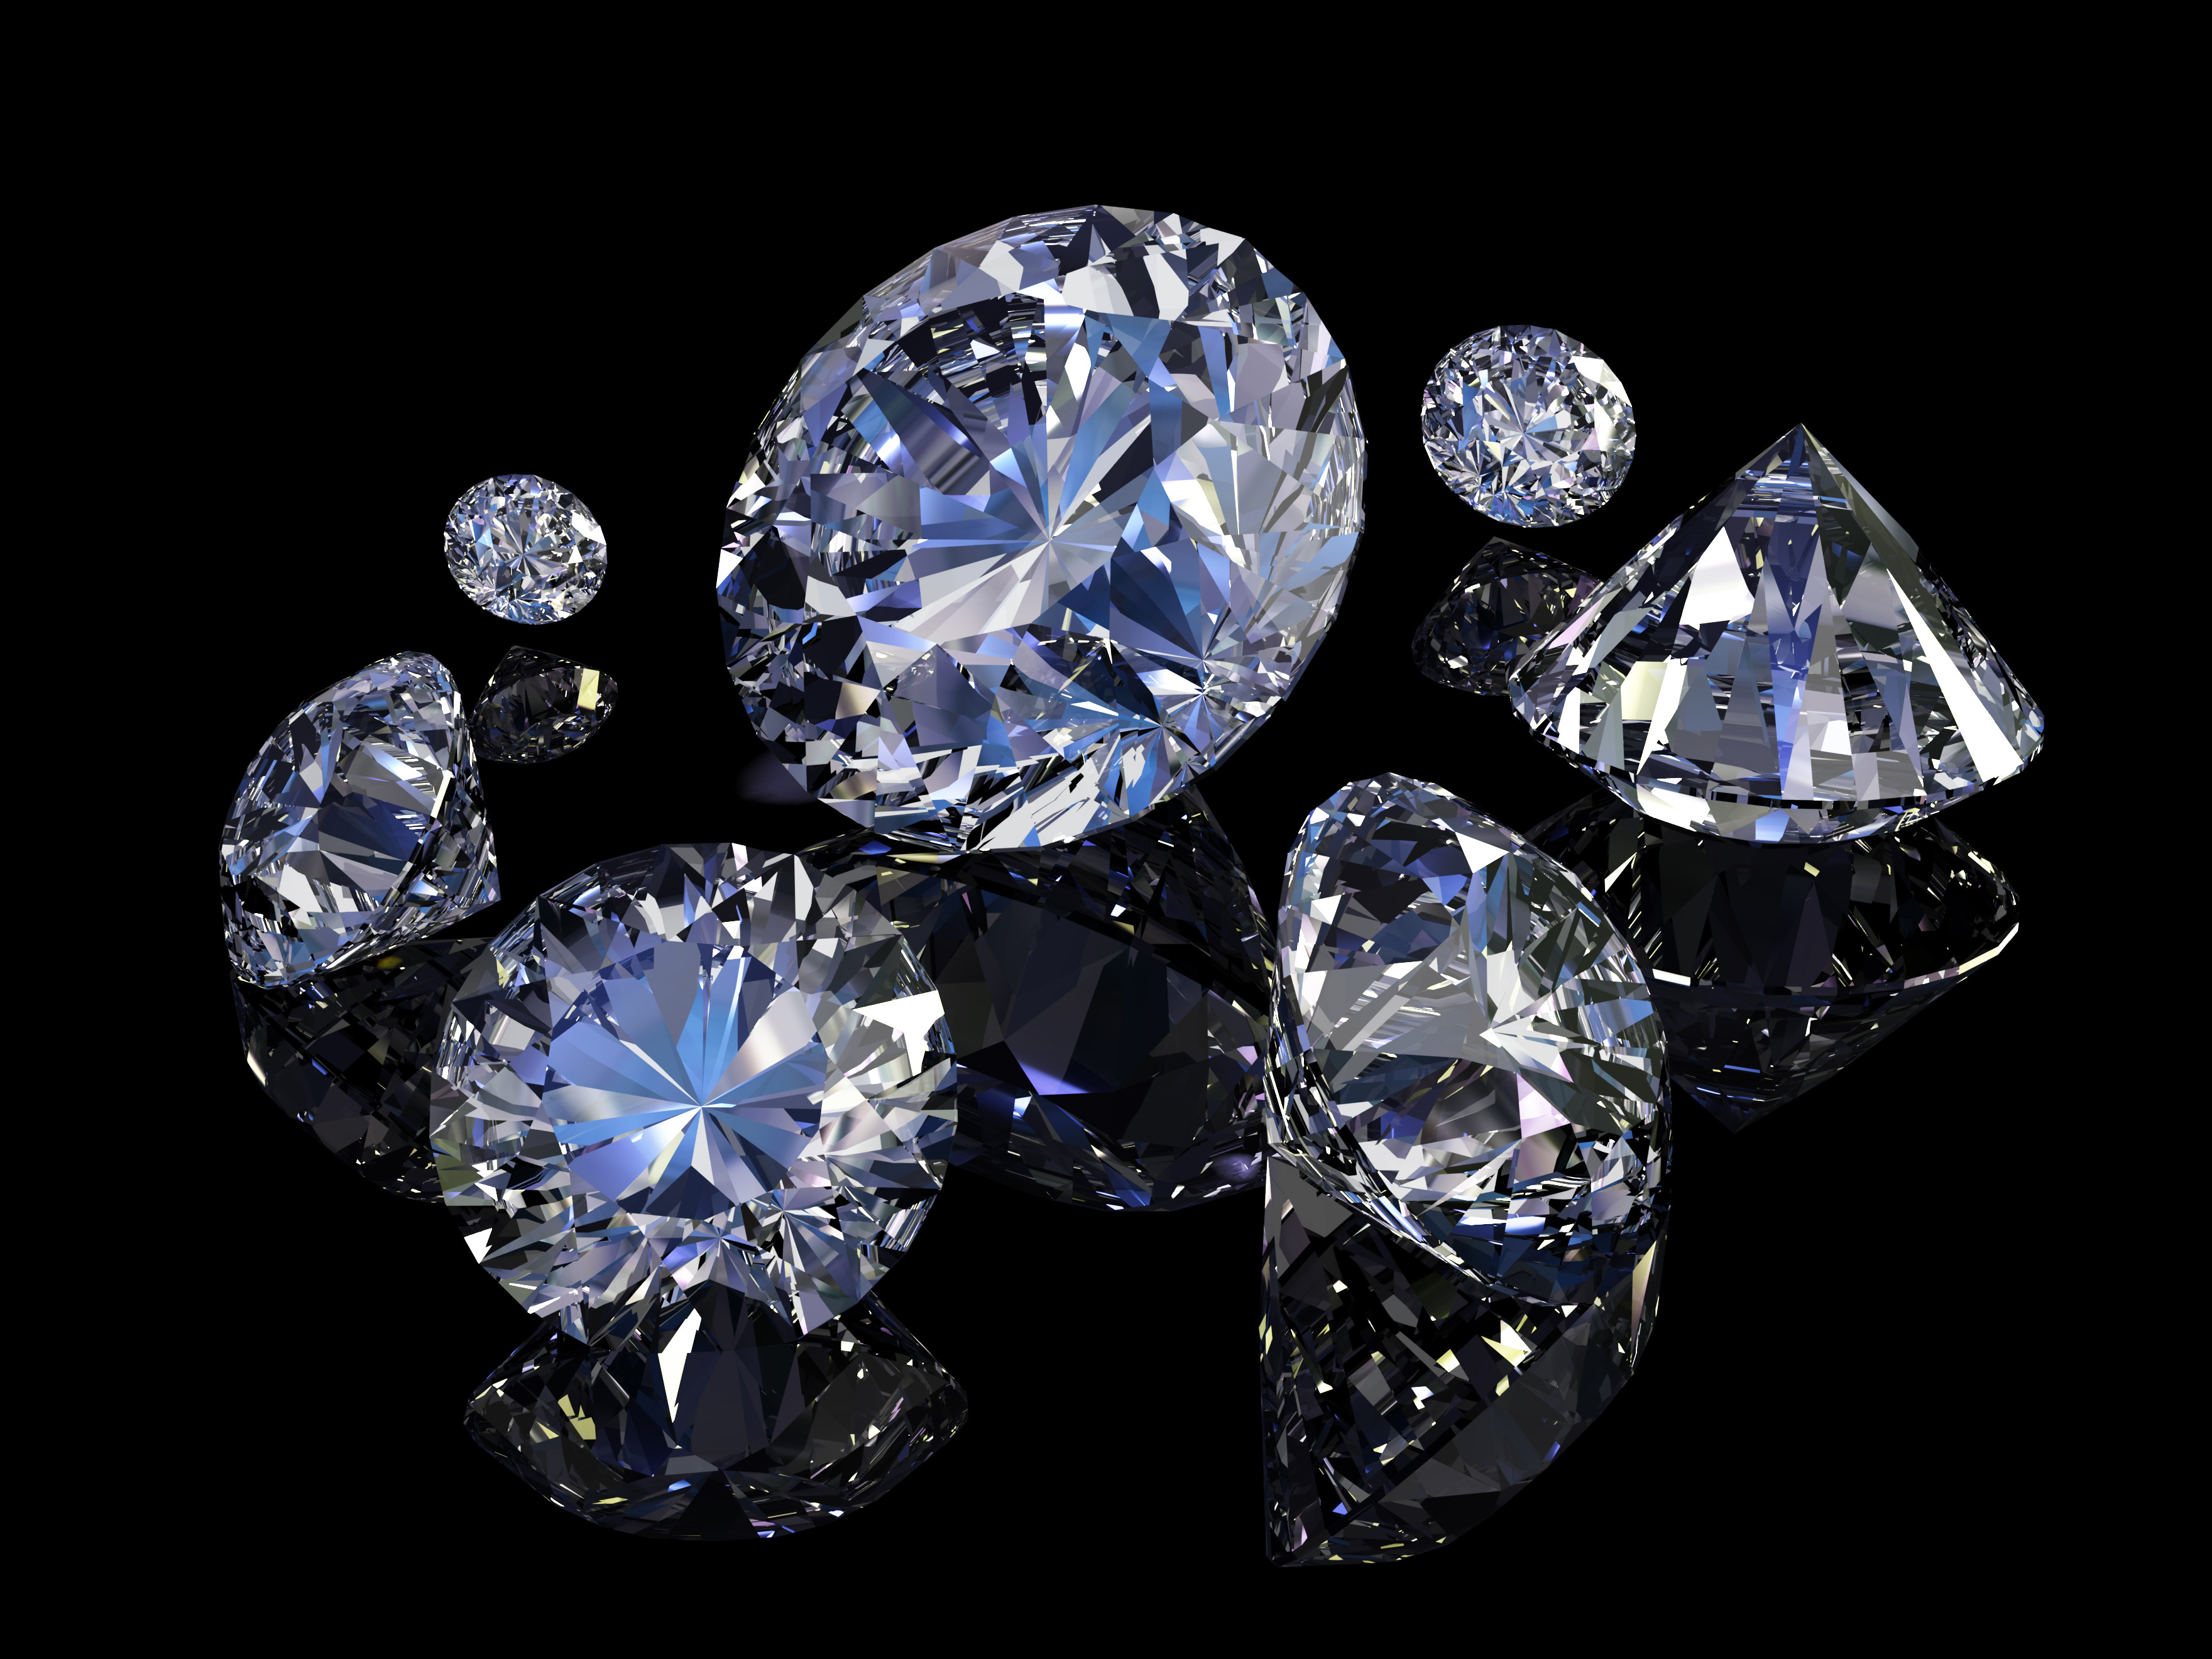
Effect on Price from the diamonds for C’s
Name: Mark McGuire
Date: 4/14/2018

Slide 2
Objective
Understand factors which may influence the price of a diamond.
Determine which of the four C’s influence the price of a diamond the most.

Slide 3
Background Data
When purchasing a diamond what are the most important characteristics to look for.
There are four C’s in diamond grading
Carat, Clarity, Cut , and Color
Reference related studies and their results
Springfield, MA Obstetrics study
Journal articles

Slide 4
Methods
Null Hypothesis: There is no statistical significance between a diamonds price and Carat, Cut, Clarity, and Color.
Alternate Hypothesis: There is no statistical significance between a diamonds price and Carat, Cut, Clarity, and Color.
Dataset:
Diamonds in the ggplot2 library
Linear Regression model with analysis of R-squared values

Slide 6
Four C’s
Carat
range from (0.2 – 5.01)
Cut
Fair, Good, Very Good, Premium, Ideal
Clarity
(I1 (worst), SI2, SI1, VS2, VS1, VVS2, VVS1, IF (best))
Color
from J (worst) to D (best)

Slide 10
Results
R-squared values:
Price ~ carat : 0.848
Price ~ cut: 0.012
Price ~ color: 0.032
Price ~ clarity: 0.026
Price ~ carat + cut: 0.855
Price ~ carat + color: 0.863
Price ~ carat + clarity: 0.894
Price ~ carat + clarity + color: 0.913
Price ~ carat + clarity + cut: 0.896
Price ~ carat + clarity + color +cut : 0.915

Slide 11
Conclusion
Carat is the most important ”C” when determining the price of a diamond
Clarity is slightly more significant that color but both are far less than carat
Cut is the least significant

